Slide 1
CREDIT EDA CASE STUDY
BY KETAN SONI AND SMIT JAKHOTIA

Slide 2
CATEGORICAL UNIVARIATE ANALYSIS FOR TARGET 1 (DEFAULT) And Target 0 (NON - DEFAULT) FOR NEW Application Dataset

Slide 3
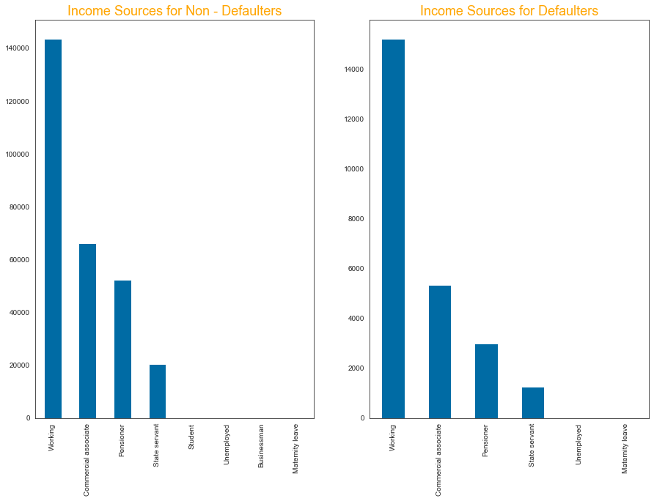
DISTRIBUTION OF Income Source
For Income Type Working, Commercial associate the number of credits are higher than others.
Less number of credits for income type Student , Unemployed and Maternity leave.
We also observe a decrease in the Defaulters who are Pensioners and an increase in the Defaulters who are Working when compared the percentage of both Defaulters and Non-Defaulters.

Slide 4
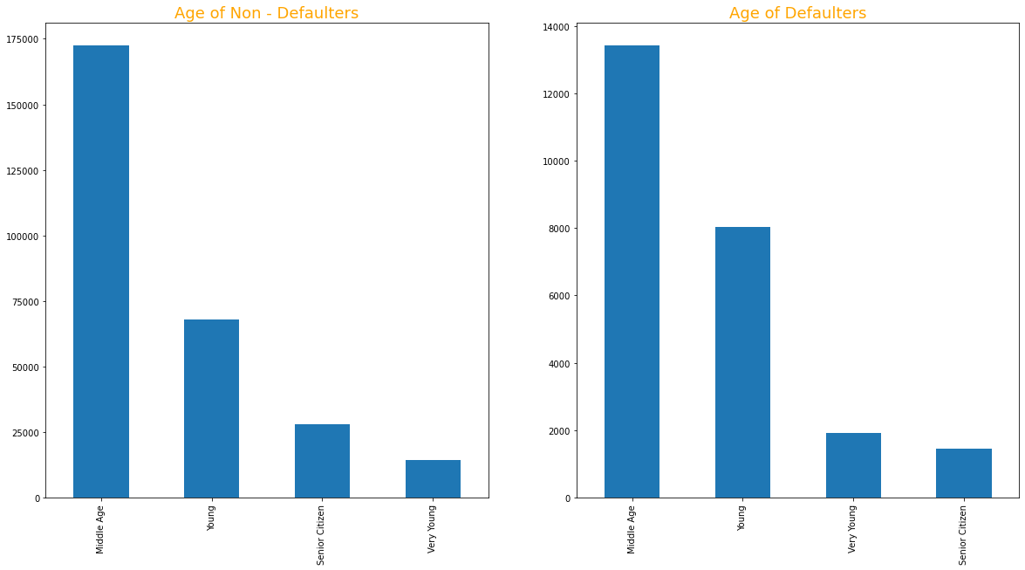

Slide 5
DISTRIBUTION OF Age GRoups
We observe that there is an increase in the Defaulters who are young in age when compared to the percentages of Defaulters and Non Defaulters

Slide 6
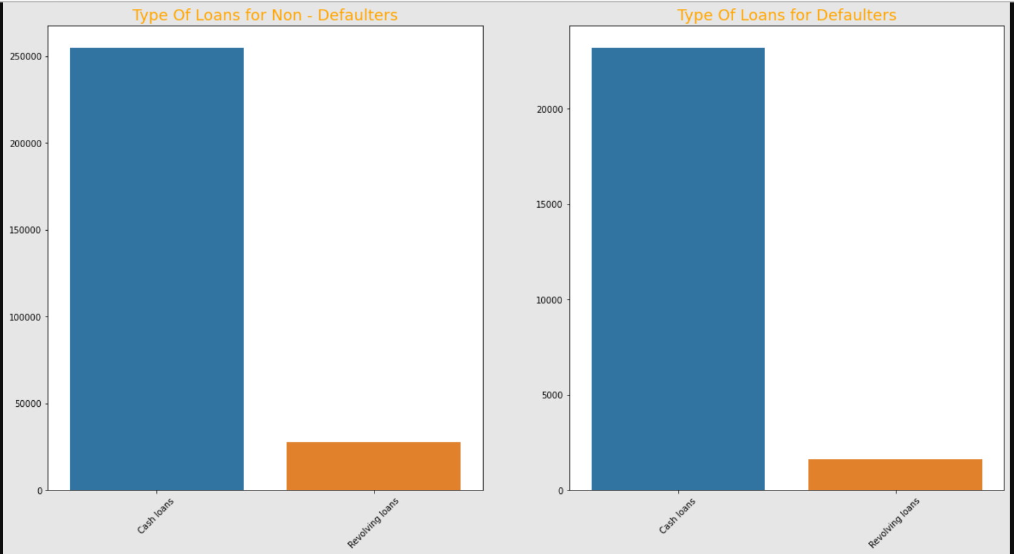

Slide 7
Distribution for LOAN type
We can observe that cash loans are mostly preferred by both Defaulters and Non-Defaulters. Though there is a significant decrease in Defaulters who go for revolving loans

Slide 8
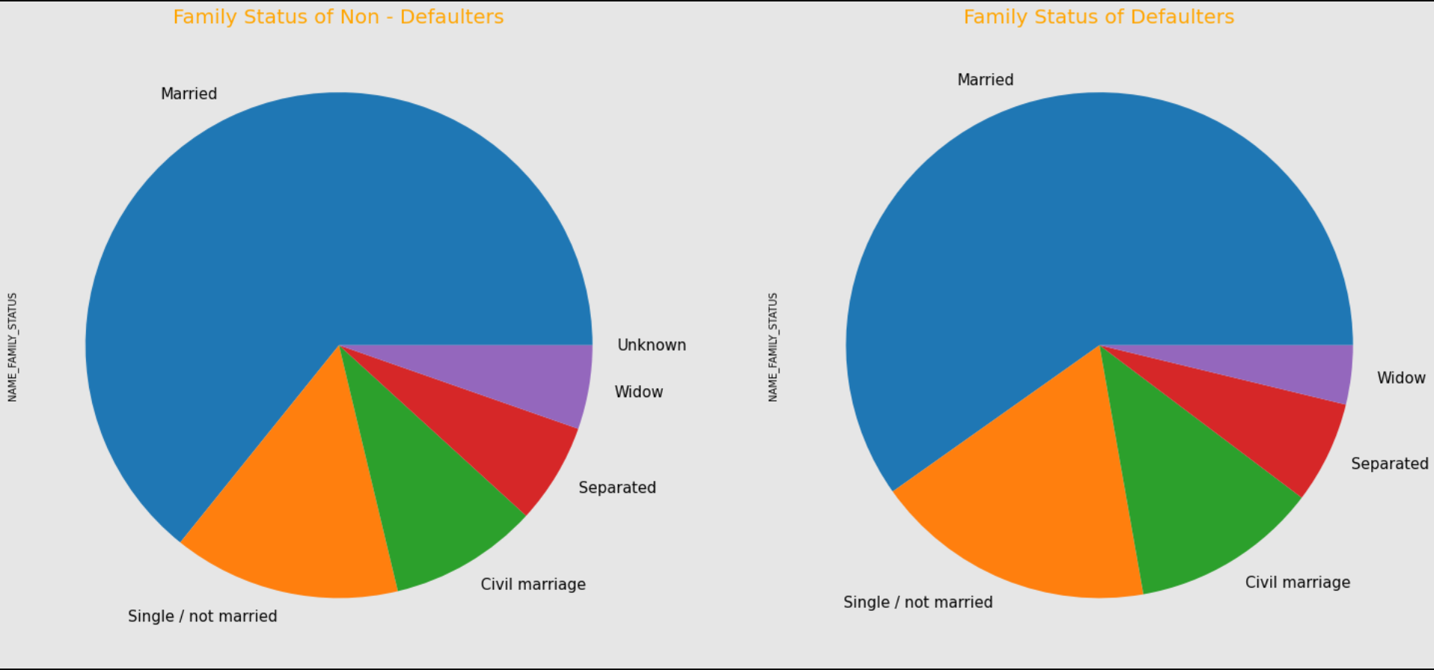
.

Slide 9
DISTRIBUTION OF FAMILY Status
We observe an increase in Defaulters for both Single/not married and Civil Marriage, where as there is a decrease in Widow defaulters when compared with both Defaulters and Non-Defaulters

Slide 10
TARGET Analysis for Numerical Variables

Slide 11
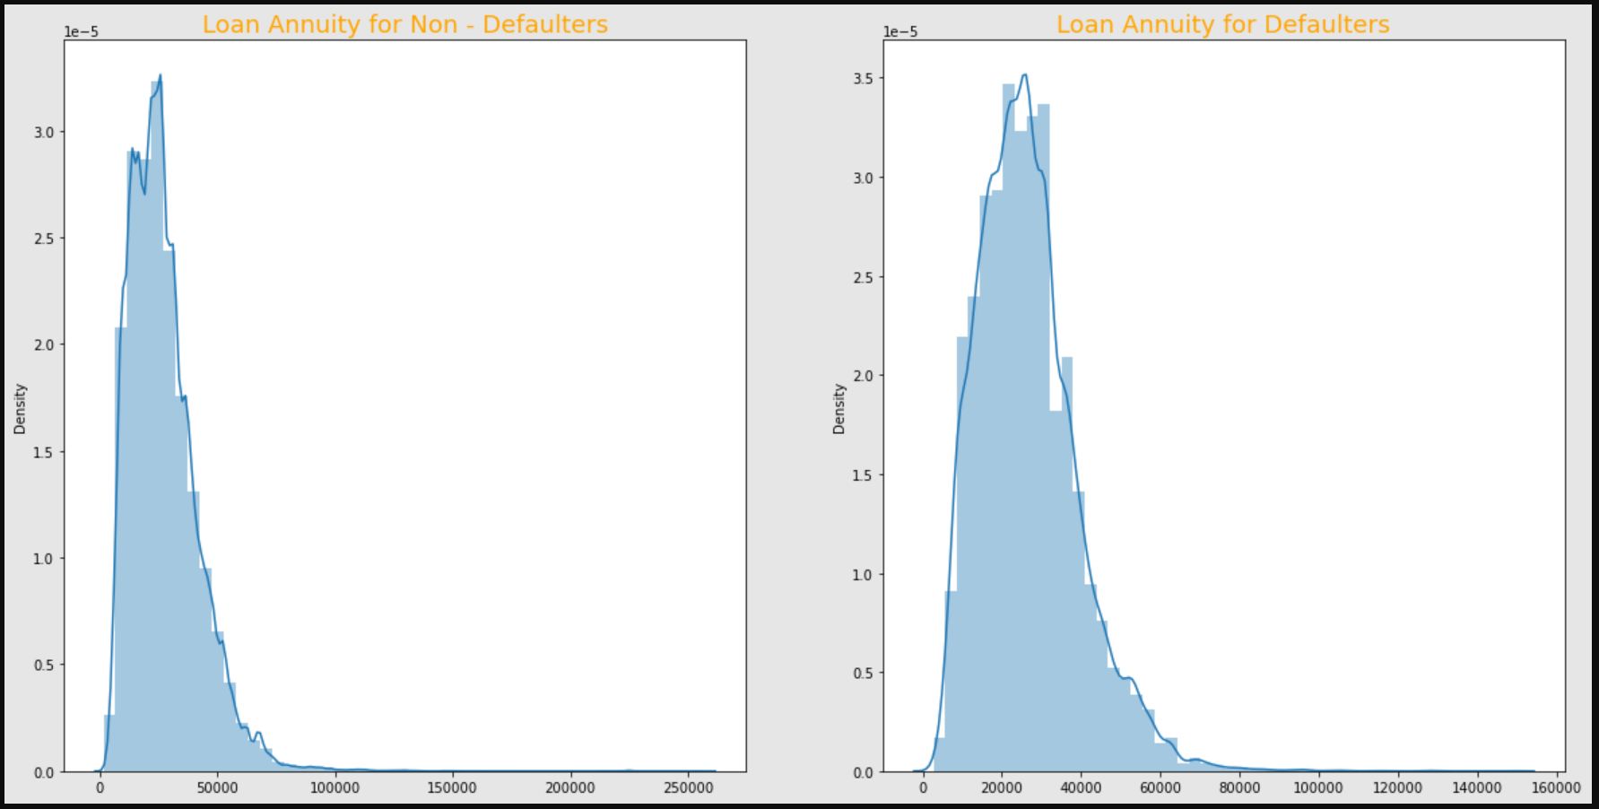
LOAN Annunity
We can observe that the distribution curve is quite normal for both Defaulters and Non-Defaulters.

Slide 12
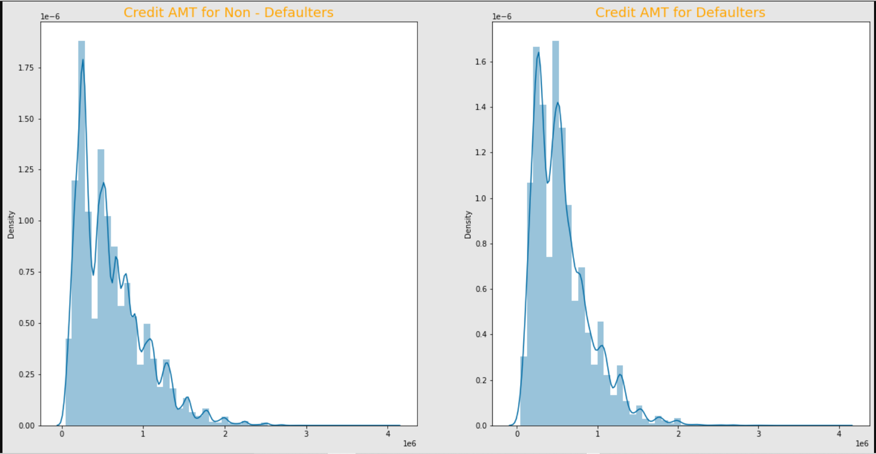
Credit Amount
We can observe that the distribution curve is not normal for both Defaulters and Non-Defaulters. We can say that the credit amount of the loan varies.

Slide 13
Bivariate analysis for new application dataset

Slide 14
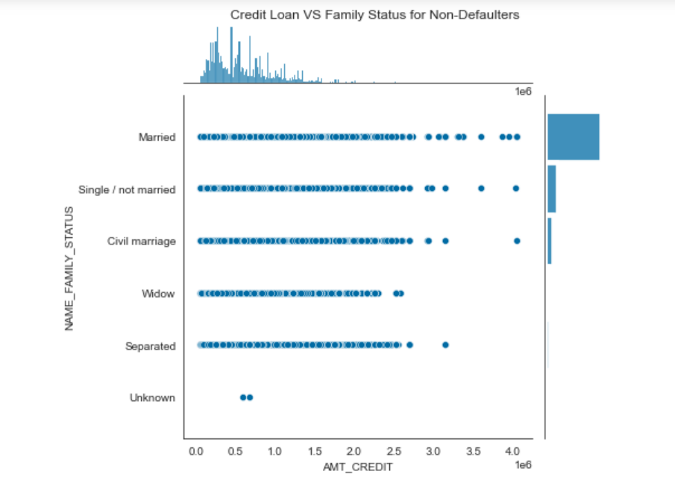
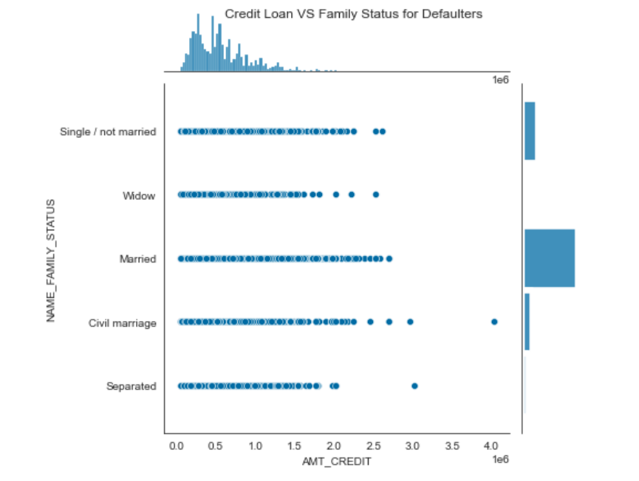
AMT_CREDIT vs NAME_FAMILY_STATUS
We can observe that people having Single/not married and Married Family Status who are non-defaulters have more credit loan amount as compared to defaulters.

Slide 15
Correlation of target 0 (NON - Defaulter) and Target 1 (defaulter)

Slide 16
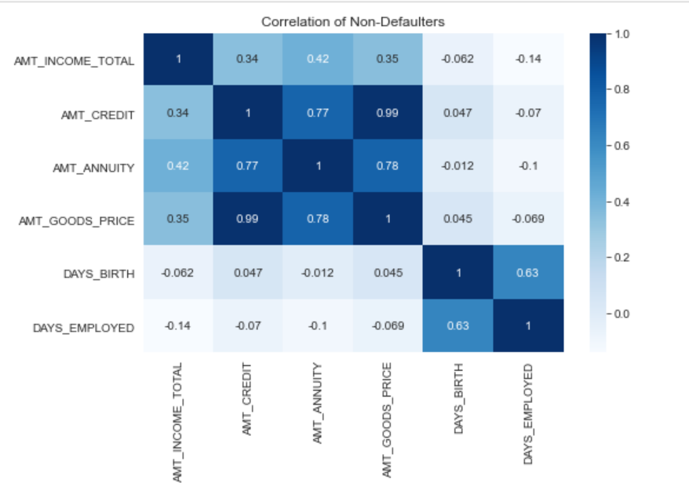

Slide 17
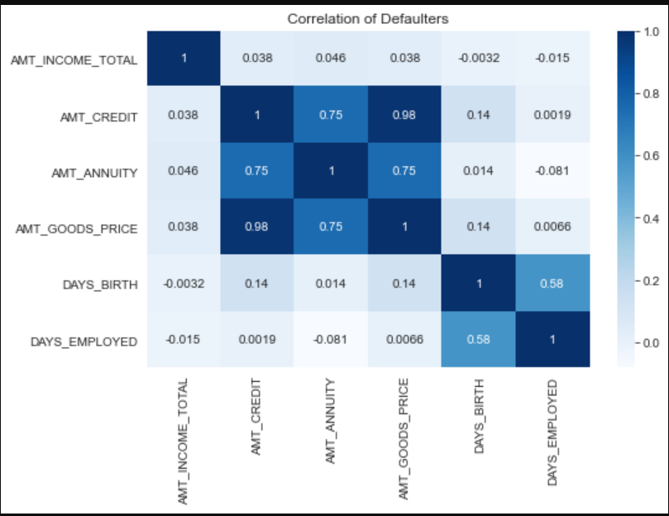

Slide 18
Insights for Correlation of target 0 and target 1
Credit amount is inversely proportional to the date of birth, which means Credit amount is higher for low age and vice-versa.
We observe that there is a high correlation between goods price and credit amounts.
Also we observe that the goods price with low amount have high loan annuity in defaulters.
In non-defaulters, people with all age groups tend to take higher credit loan as compared to non-defaulters.

Slide 19
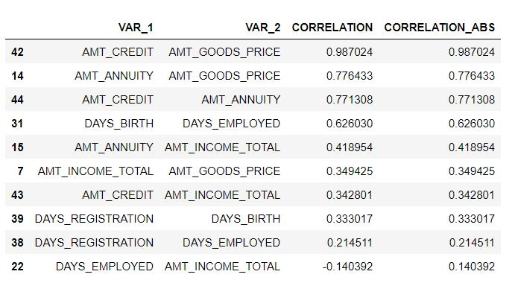
TOP 10 CORRELATION FOR DEFAULTERS

Slide 20
Data analysis for previous application dataset

Slide 21
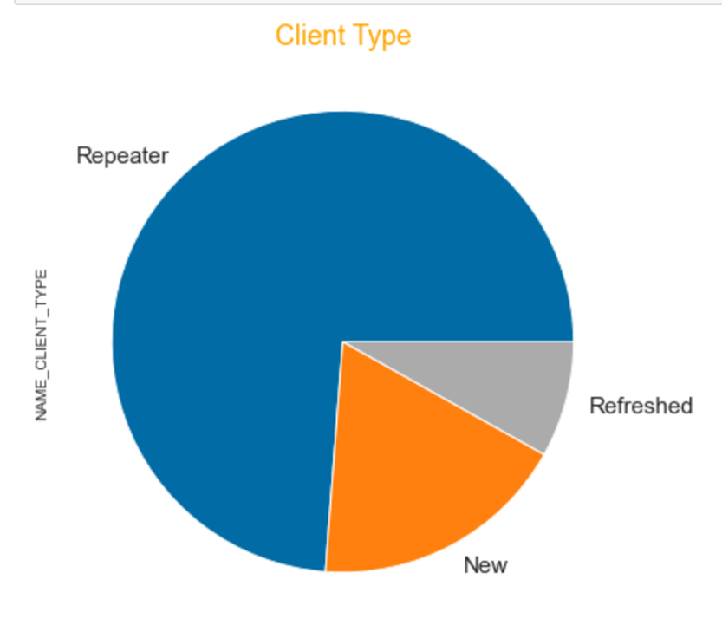
Insights for NAME_CLIENT_TYPE
We can observe that there is a huge amount of clients who are repeaters.

Slide 22
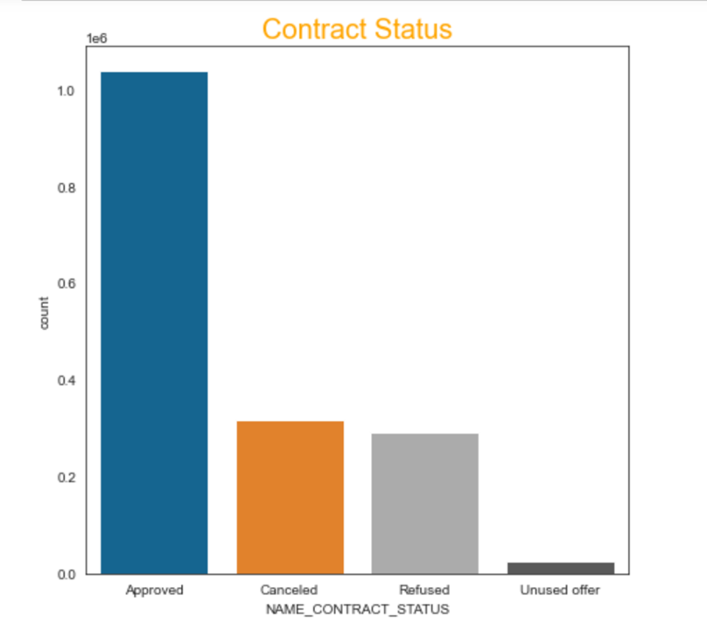
Insights for NAME_contract_status
We can observe that majority loans are approved. Also, Canceled and Refused Loans are almost equal.

Slide 23
UNIVARIATE ANALAYSIS FOR AMT_ANNUITY, AMT_CREDIT and AMT_GOODS_PRICE

Slide 24
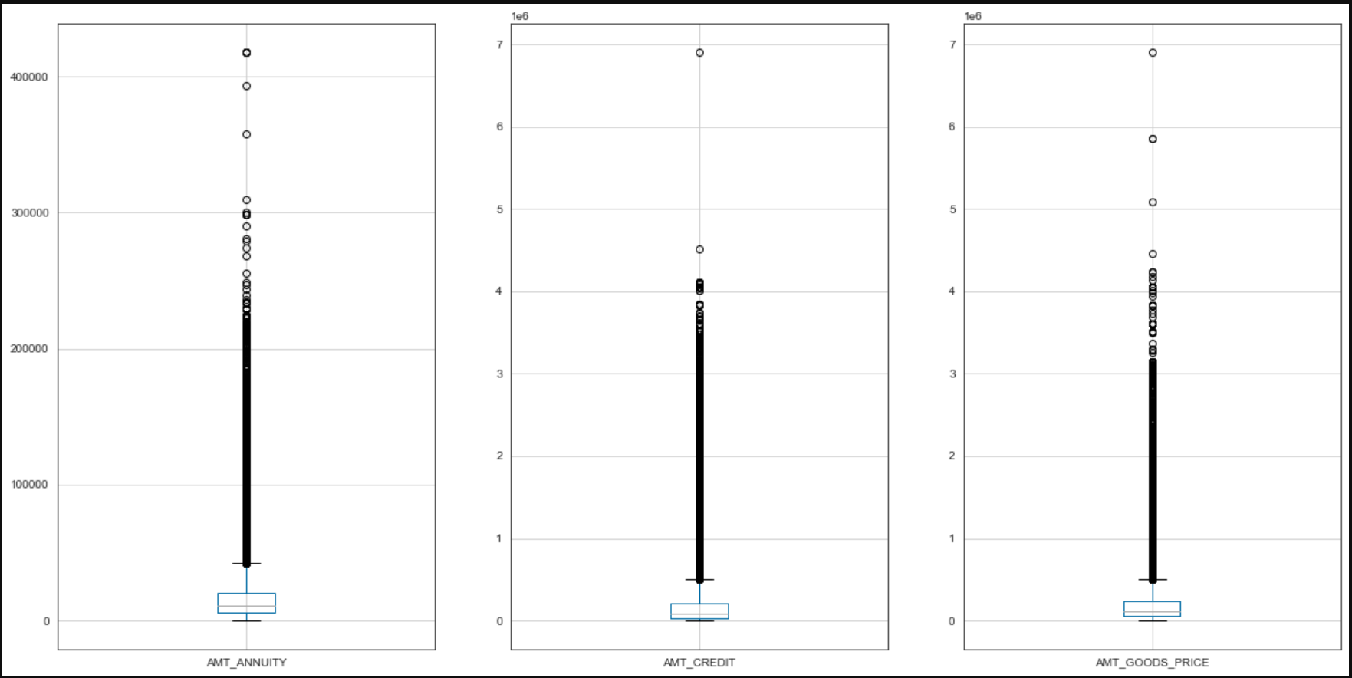
We can observe that there are some outliers in AMT_ANNUITY, AMT_CREDIT and AMT_GOODS_PRICE

Slide 25
BIVariate analysis for previous application dataset

Slide 26
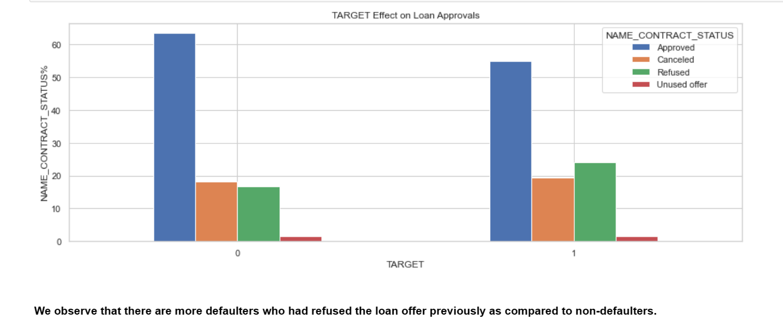
TARGET VS NAME_CONTRACT_STATUS

Slide 27
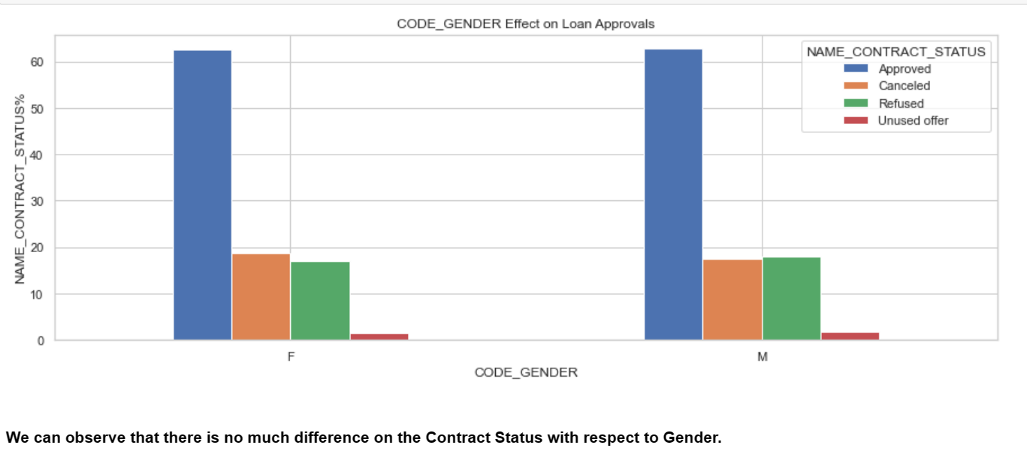
CODE_GENDER VS NAME_CONTRACT_STATUS

Slide 28
Conclusion
Banks should consider Income Type of Student , Pensioner and Businessman for successful payments.
Banks should focus less on Income Type Working as they are having most number of unsuccessful payments.
Banks should consider clients from housing type With Parents as Top priority as they are having least number of unsuccessful payments.
Female clients with higher education have less chances of being a defaulter.
Clients with high income category can be preferred for bank loans.
Group whose previous loan status was refused have significant chance of defaulting.

Slide 29
THANK YOU !!

